Slide 1
Subclassing UIView

Slide 2
View Hierarchy
Top dog is UIWindow
  Created when Application launches
  Container for all Views in your application
Views can also hold sub-Views
Each View renders itself, creates a Layer
  Then each of its sub-Views do the same thing
  Layers are drawn in order of hierarchy
Apple provides lots of Views that pre-know how to render themselves
  E.g., UILabel
    you tell it the text, font, size, etc., but it knows what color each individual pixel should be

Slide 3
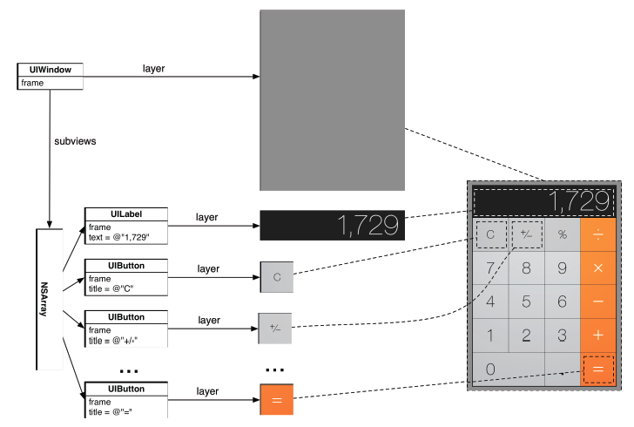
View Hierarchy

Slide 4
Custom Views
You might want a View that is not pre-provided by Apple
Create a new Class (*.m and *.h files) and subclass UIView
  This custom View will have to:
  Know how to draw itself
  Handle events (e.g., touch events)
  Exists within a hierarchy of views (with the application window being the root)

Slide 5
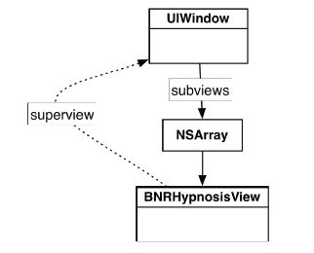
View Hierarchy
The AppDelegate’s window holds an array of subviews
BNRHypnosisView’s superview is window

Slide 6
View Hierarchy
Now Xcode requires the window to have a root VC
  Root VC will hold array of sub-views
UIWindow
Root VC
NSArray
firstView

Slide 7
View Hierarchy
UIWindow
UIWindow
Root VC
Root VC
NSArray
NSArray
firstView
firstView
secondView
NSArray
secondView

Slide 8
View Hierarchy
UIWindow
Root VC
NSArray
UIView
BNRHypnosisView
firstView
thirdView
thirdView obstructs firstView

Slide 9
Custom Views
Override drawRect method
Do whatever you want!!!!

